Slide 1

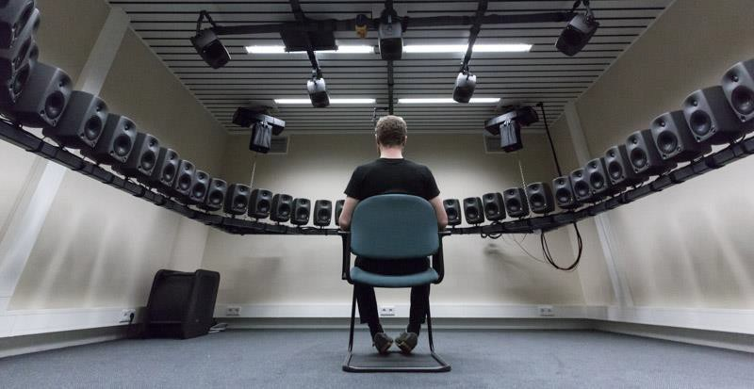
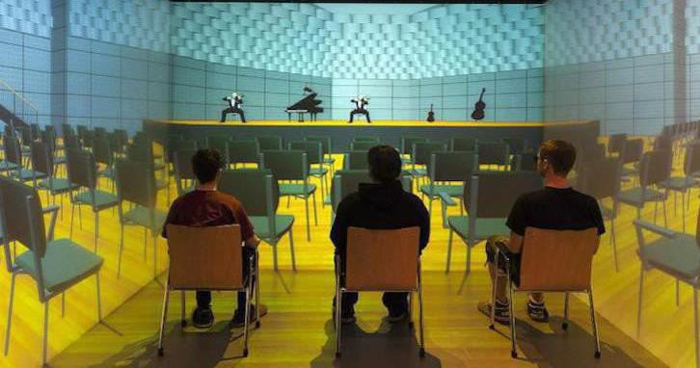
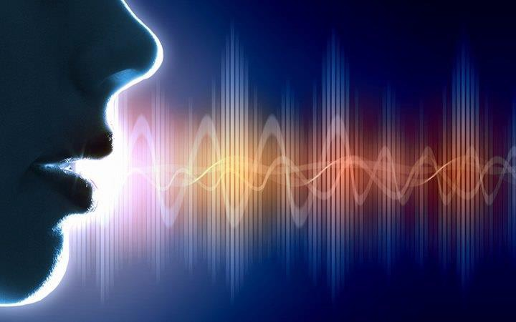
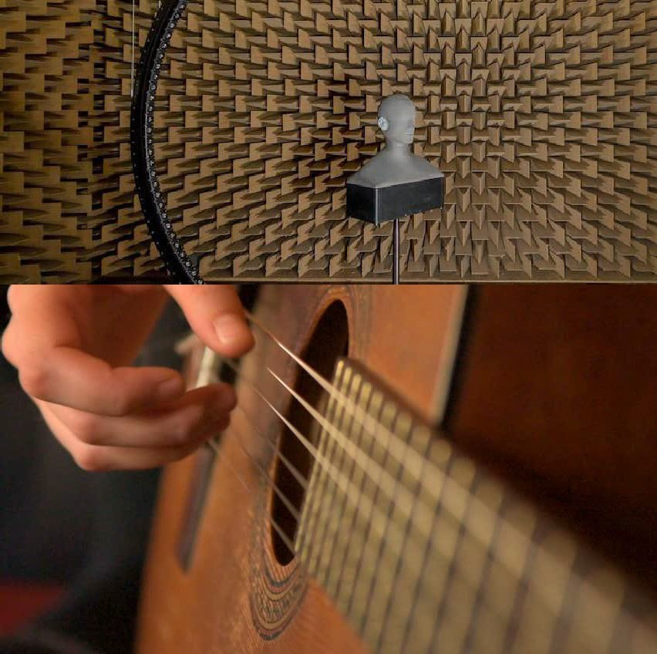

The Science of Sound
Module 2
Auditory Demonstrations
Tanmayee Pathre (t.u.pathre@tue.nl)
Building Acoustics Group
Pictures from Google

Slide 2
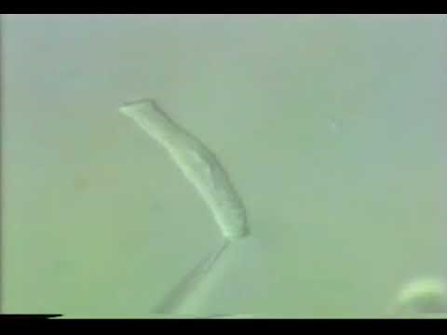
Anatomy of Ear – Inner Ear
The Inner ear – The Dancing Hair cell
https://www.youtube.com/watch?v=wKEhjpqpzCE
Source: YouTube

Slide 3
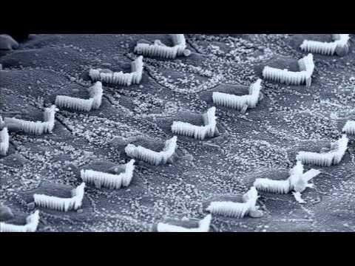
Anatomy of Ear
The Inner ear – The Dancing Hair cells
https://www.youtube.com/watch?v=K-cRIO4gQmk

Slide 4
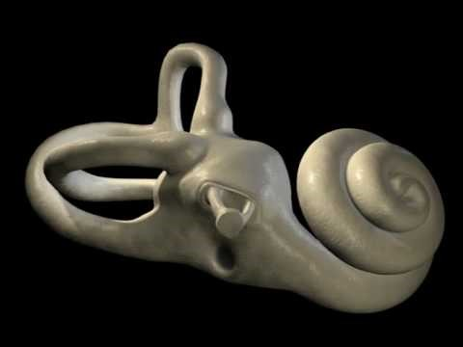
Auditory Transduction
https://youtu.be/46aNGGNPm7s

Slide 5

Spatial Hearing
Listening Demonstration
https://www.youtube.com/watch?v=IUDTlvagjJA

Slide 6


Pitch
Listening Demonstration – Pitch
In complex tones, the fundamental frequency determines the pitch, even if this component is absent in the complex.
Three demonstrations were created to illustrate pitch as an auditory phenomenon relating to frequency.
This demonstration investigates how pitch is perceived in time.
Each track plays time bursts of sound.
Initially the tones will sound like pops or blips, but as the tones increase in time duration they will begin to have pitch. Each demonstration uses a different frequency of tone.
Track 1
Track 2
Track 3
Source: Perceptual Audio Demonstrations

Slide 7

Timbre
Listening Demonstration – Timbre
Demonstration to understand differences in Timbre
Track 1
Track 2
Source: Plomp CD and Perceptual Audio Demonstrations

Slide 8
Sound Level
Listening demonstration – Sound Level (Please do NOT wear headphones)
Ticks of a clock (30 dB)
Painting (40 dB)
Cutting paper (50 dB)
Washing hands (60 dB)
Toilett flush (70 dB)
Vacuum cleaner (noisy model, 80 dB)
Stone drill (100 dB)
Source: SUVA CD track 18

Slide 9

Loudness
Listening Demonstration – Level
Level differences of 0 tot +10 dB between successive sounds
Relative levels of individual sounds
Try to find out which difference leads to a perceivable difference
0 dB, +1 dB, 0 dB, +3 dB, 0 dB, +6 dB, 0 dB,+10 dB, 0 dB
Source: SUVA CD track 14

Slide 10
Masking and Critical Bands
Listening Demonstration – Loudness
Demonstration shows that the perceived loudness of tones varies at equal sound intensity.
Source: Perceptual Audio Demonstrations

Slide 11
Masking and Critical Bands
Listening Demonstration – Masking
Pure tones that are close together in frequency mask each other better than those widely separated.
A single tone is played, followed by the same tone and a higher frequency tone. The higher frequency tone is reduced in intensity first by 12 dB, then by steps of 5 dB. The sequence above is repeated twice. The second time the frequency separation between the tones is increased
Pure tones also mask higher frequencies better than lower frequencies.
High Frequencies masked →
Low frequencies are masked →
Source: Perceptual Audio Demonstrations

Slide 12
Masking and Critical Bands
Listening Demonstration – Masking
Tone of greater intensity masks a broader ranger of tones than a tone of less intensity
A single tone is played, followed by the same tone and a higher frequency tone. The higher frequency tone is reduced in intensity first by 10 dB, then by steps of 3 dB. The sequence above is repeated twice, the second time increasing the intensity of the single tone by 28 dB.
Source: Perceptual Audio Demonstrations

